Slide 1

Vel Tech Rangarajan Dr. Sagunthala R&D Institute of Science and Technology
School of Computing
Department of Computer Science and Engineering
10211CS224 / FULL STACK APPLICATION DEVELOPMENT (JAVA)
END SEMESTER PROJECT REVIEW
Date: 06-05-2026
“TICKET BOOKING OF AN INTERNAL DEPARTMENT EVENT”
SDG: SDG No – SDG 4 – Quality Education
Presented By:
L.Sesha Sai – VTU26580– 23UECS0307
Courses Handling Faculty:
Dr. HAFIZUR RAHMAN - B.E., M.Tech., Ph.D. ASSISTANT PROFESSOR

Slide 2
INTRODUCTION
Problem: Students and staff often face difficulties in booking tickets for internal department events like technical fests, seminars, and workshops due to manual registration processes, lack of centralized systems, and limited seat tracking.
Why it matters: An efficient ticket booking system ensures smooth event participation, avoids overcrowding, and helps organizers manage registrations accurately while providing a better experience for users.
Real-world relevance: This system is useful for colleges and organizations to handle event registrations digitally, reducing paperwork and enabling quick access for students, faculty, and event coordinators.
What the system does: A web-based application built using React.js that allows users to browse upcoming events, book tickets, and manage their registrations in a structured and user-friendly way.
Key features: User authentication, event listing (technical fest, seminars, workshops), ticket booking, seat availability tracking, dashboard overview, and secure data management.
User experience: A clean, responsive, and interactive interface with easy navigation, real-time updates on ticket availability, and a seamless booking process.
Benefits: Saves time, reduces manual effort, improves event organization, and provides a hassle-free booking experience for users.
Impact / SDGs: Supports SDG 9 – Industry, Innovation and Infrastructure by promoting digital solutions and SDG 4 – Quality Education by enhancing access to academic and technical events.
1
2
3
4
5
6
7
8
9

Slide 3
PROBLEM STATEMENT
1
Time-consuming: Manual event registration and ticket booking consume significant time and effort for both users and organizers.
Limited accessibility: Users may not have a centralized platform to view all upcoming department events .
Poor event management: Difficulty in tracking registrations, seat availability, and participant details efficiently.
Data loss risk: Manual or unstructured systems may lead to loss of participant and booking information.
Security concerns: User data and booking details may not be handled securely in traditional systems.
No real-time updates: Users cannot get instant updates on ticket availability or event status.
Need: A secure and responsive web application to manage event listings, ticket booking, and user data efficiently using modern technologies like React.js.
2
3
4
5
6
7
8
9

Slide 4
OBJECTIVE(S)
Design & develop: To build a responsive React.js-based web application that enables users to easily browse, book, and manage tickets for internal department events (target: reduce manual registration effort by ≥50%).
Implement & evaluate: To provide real-time event updates, secure user authentication, efficient ticket management, seat availability tracking, and persistent data storage for seamless user experience across sessions.
1
2
3
4
5
6
7
8
9

Slide 5
PROPOSED SYSTEM
Overview: Lightweight web application that enables users to browse, book, and manage tickets for internal department events with real-time updates and secure access.
Automation: Automated event listing, ticket booking, and seat allocation reduce manual registration effort and improve event management efficiency.
Real-Time Updates: Instant updates on event availability, booking status, and seat capacity help users make quick decisions.
Secure Access: User authentication and session management ensure that only authorized users can access booking details and personal information.
Data Persistence: Event and booking data are securely stored in databases, ensuring consistency across sessions and devices.
Collaboration: Enables organizers and participants to interact efficiently, with admins managing events and users accessing bookings seamlessly.
Event Analytics: Dashboard for organizers to track registrations, monitor attendance, and analyze event participation trends.
Advantages over current systems: Faster booking process, reduced manual work, real-time updates, secure data handling, improved event management, and a responsive web-based solution.
1
2
3
4
5
6
7
8
9

Slide 6
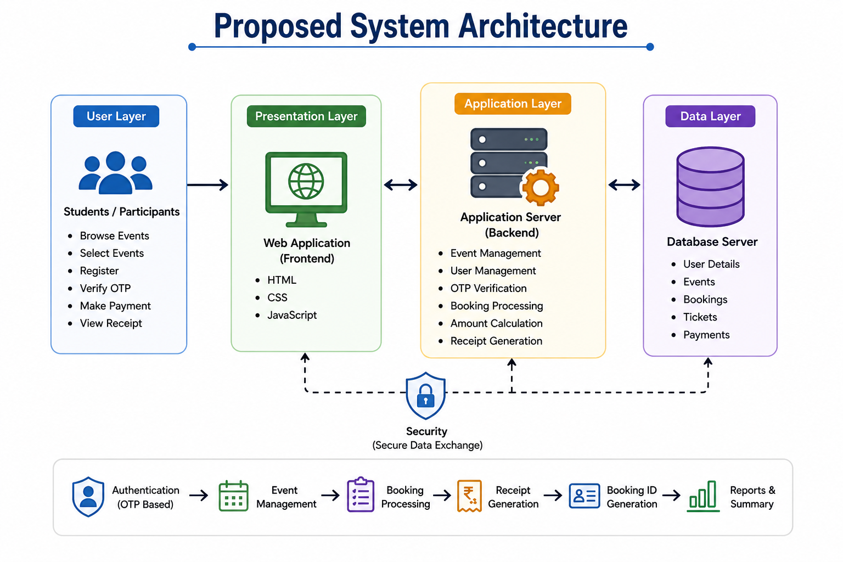
PROPOSED SYSTEM ARCHITECTURE
1
2
3
Input :
Users (students, participants, event organizers) interact with the system through the React-based UI:
Enter personal details (name, email) ,Select event, date, time, and location ,Choose number of tickets ,Submit booking request
View booking history and download QR-based tickets
Processing :
Server-side logic (or client-side logic in your current version) handles:
Input validation (email, ticket count, required fields) ,Ticket availability check, Booking creation and updates, QR code generation for each booking ,Session handling / local storage management ,API request & response handling (if backend is used).
Database :
The system stores and manages data such as:
User details (name, email) ,Booking records (event, date, time, tickets) ,Event and location details ,Ticket availability count
(Current system: uses localStorage instead of a real database)
Output :
The system provides results back to users via UI:
Booking confirmation message ,Generated QR code for ticket validation ,Updated ticket availability count ,Booking history list
Option to delete or manage bookings
4
5
6
7
8
9

Slide 7
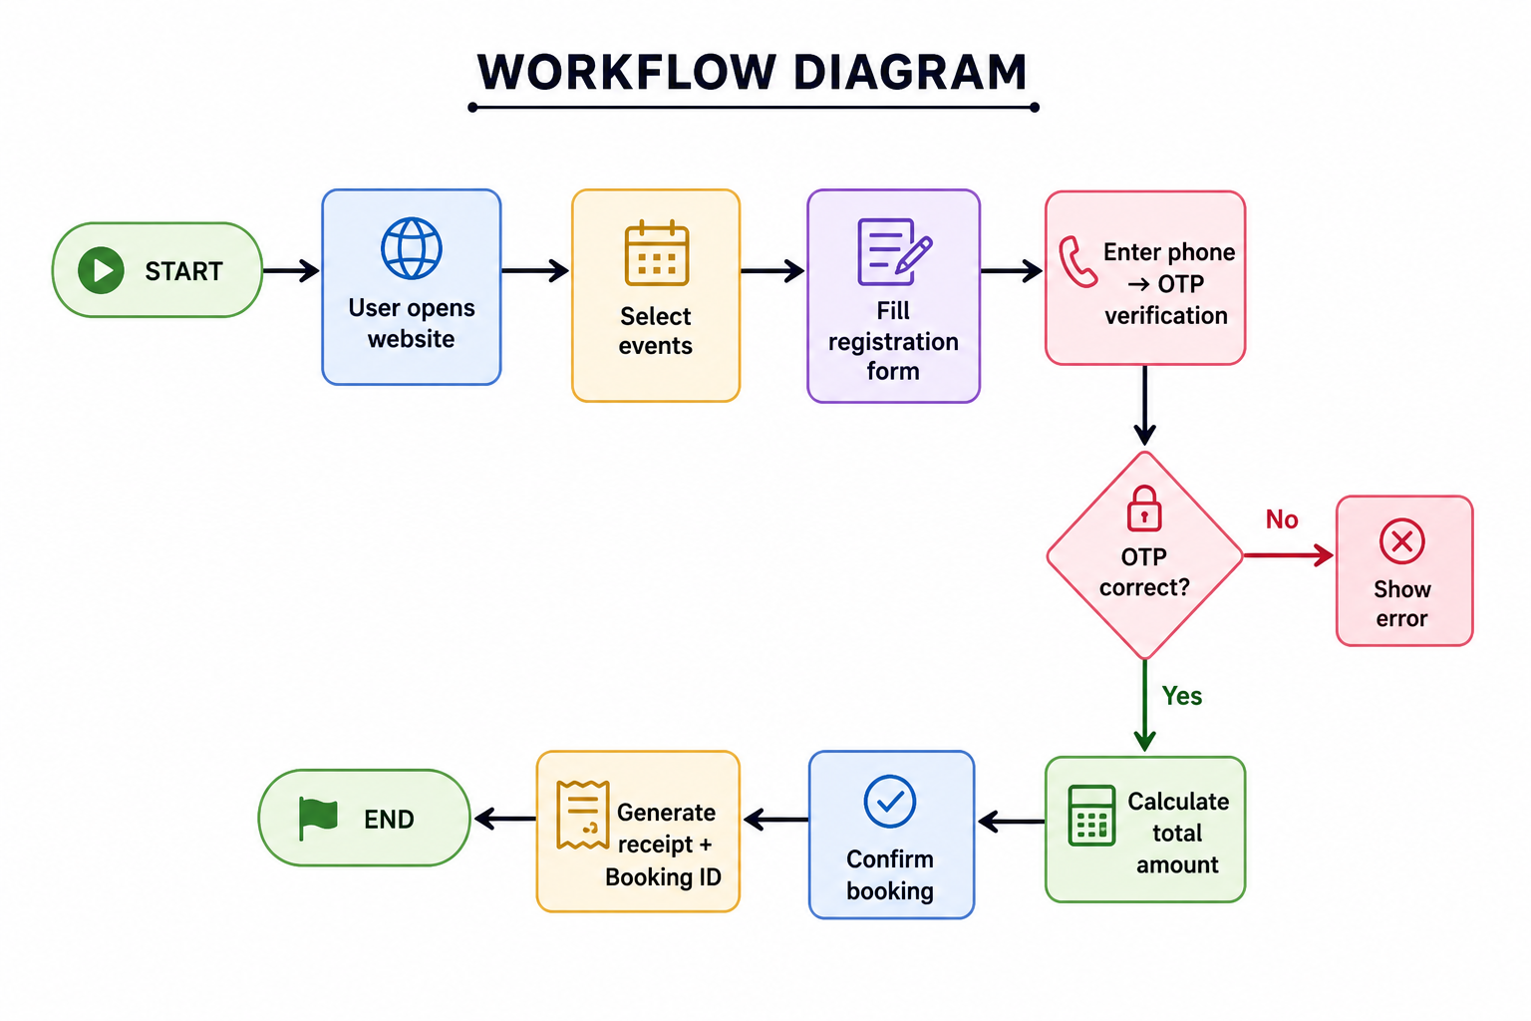
WORKFLOW
1
2
3
4
5
6
7
8
9

Slide 8
TECHNOLOGIES USED
Frontend :
HTML, CSS (Tailwind), JavaScript
Responsive UI for booking, availability, history, and QR display
Backend :
Node.js + Express
Handles APIs, validation, booking logic, authentication
Database :
Current: localStorage
Future: MySQL / PostgreSQL / MongoDB
Stores users, bookings, events, tickets
Tools :
VS Code, Git, Postman
QRCode.js for ticket generation
Requirements:
Browser (Chrome/Edge/Firefox)
Node.js (if backend used)
Minimum: 1GB RAM
1
2
3
4
5
6
7
8
9

Slide 9
MODULE DESCRIPTION
Module 1 — User Input
Collect user details (name, email)
Select event, date, time, location, tickets
Module 2 — Booking Management
Create and store bookings
Manage ticket availability
Update/delete bookings
Module 3 — Validation & Processing
Validate inputs (email, fields)
Check ticket limits
Process booking logic
Module 4 — QR Code Generation
Generate QR code for each booking
Used for ticket verification
Module 5 — Storage Management
Store bookings using localStorage
Maintain ticket count
Module 6 — History & Management
Display booking history
Delete individual bookings
Clear all bookings
Module 7 — Output & Confirmation
Show booking confirmation
Display QR code and details
Update available tickets in real-time
1
2
3
4
5
6
7
8
9

Slide 10
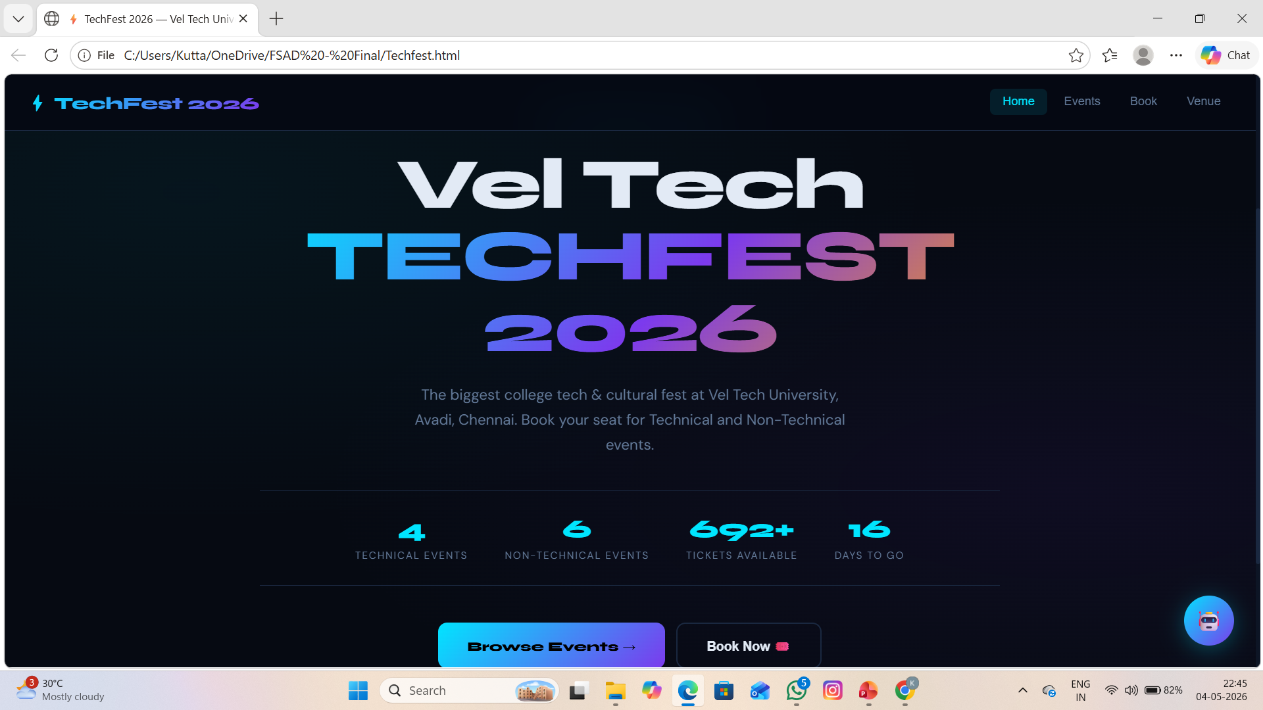
IMPLEMENTATION SCREENSHOTS
1
2
3
4
5
6
7
8
9

Slide 11
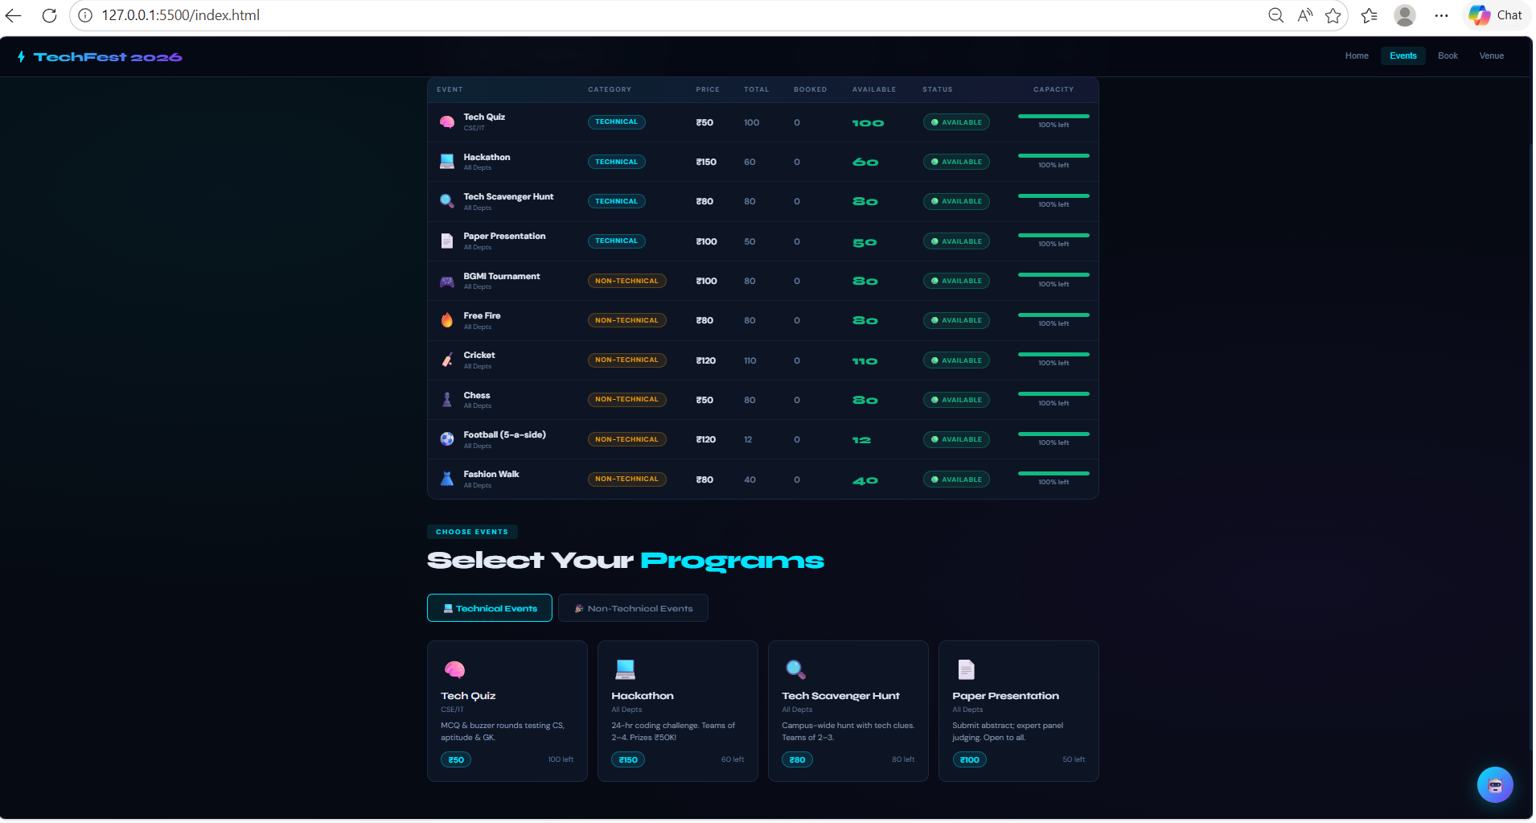
IMPLEMENTATION SCREENSHOTS
1
2
3
4
5
6
7
8(A)
9

Slide 12
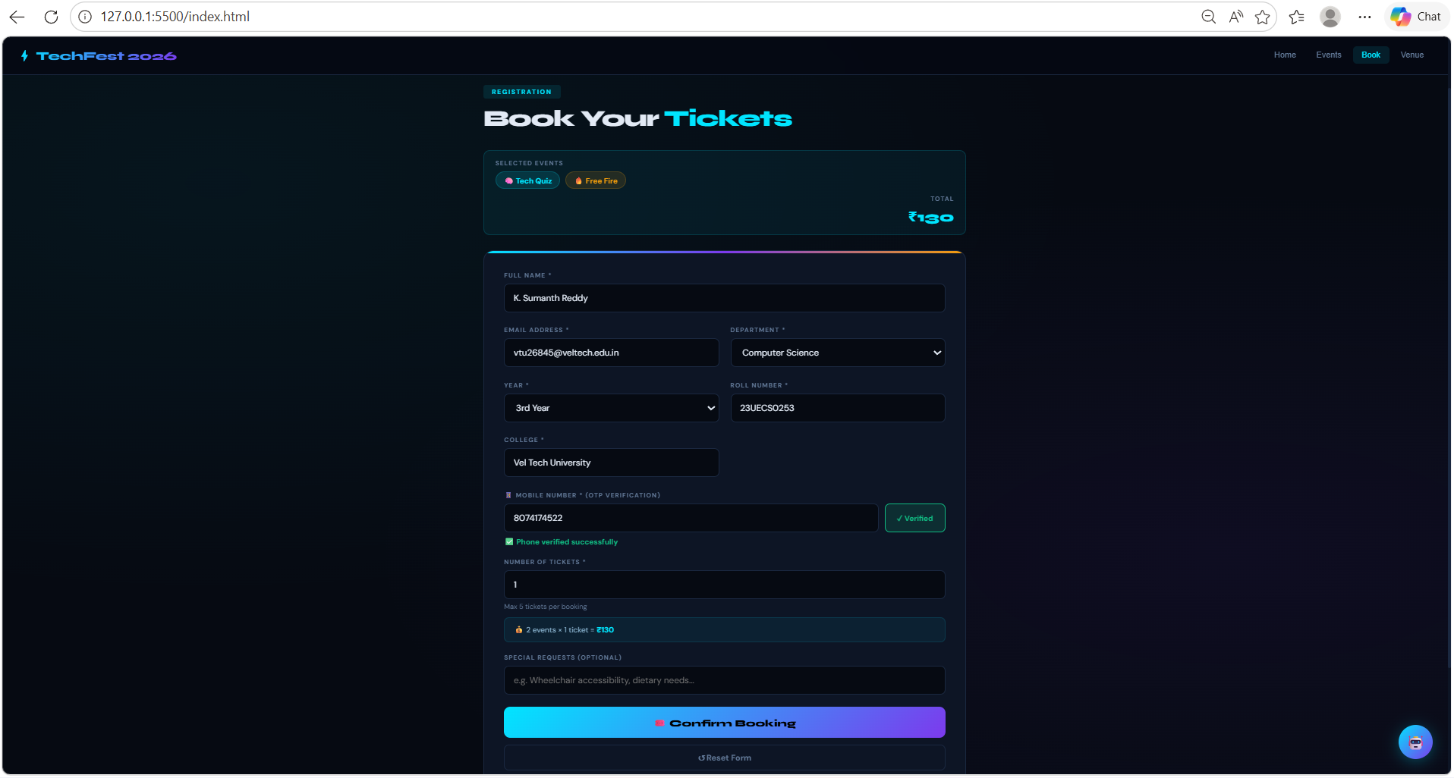
IMPLEMENTATION SCREENSHOTS
1
2
3
4
5
6
7
8(B)
9

Slide 13
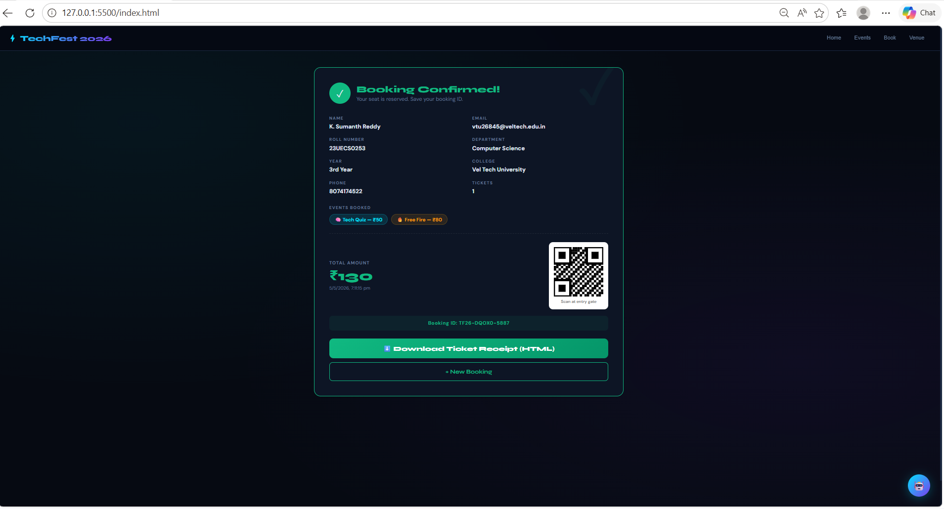
IMPLEMENTATION SCREENSHOTS
1
2
3
4
5
6
7
8(C)
9

Slide 14
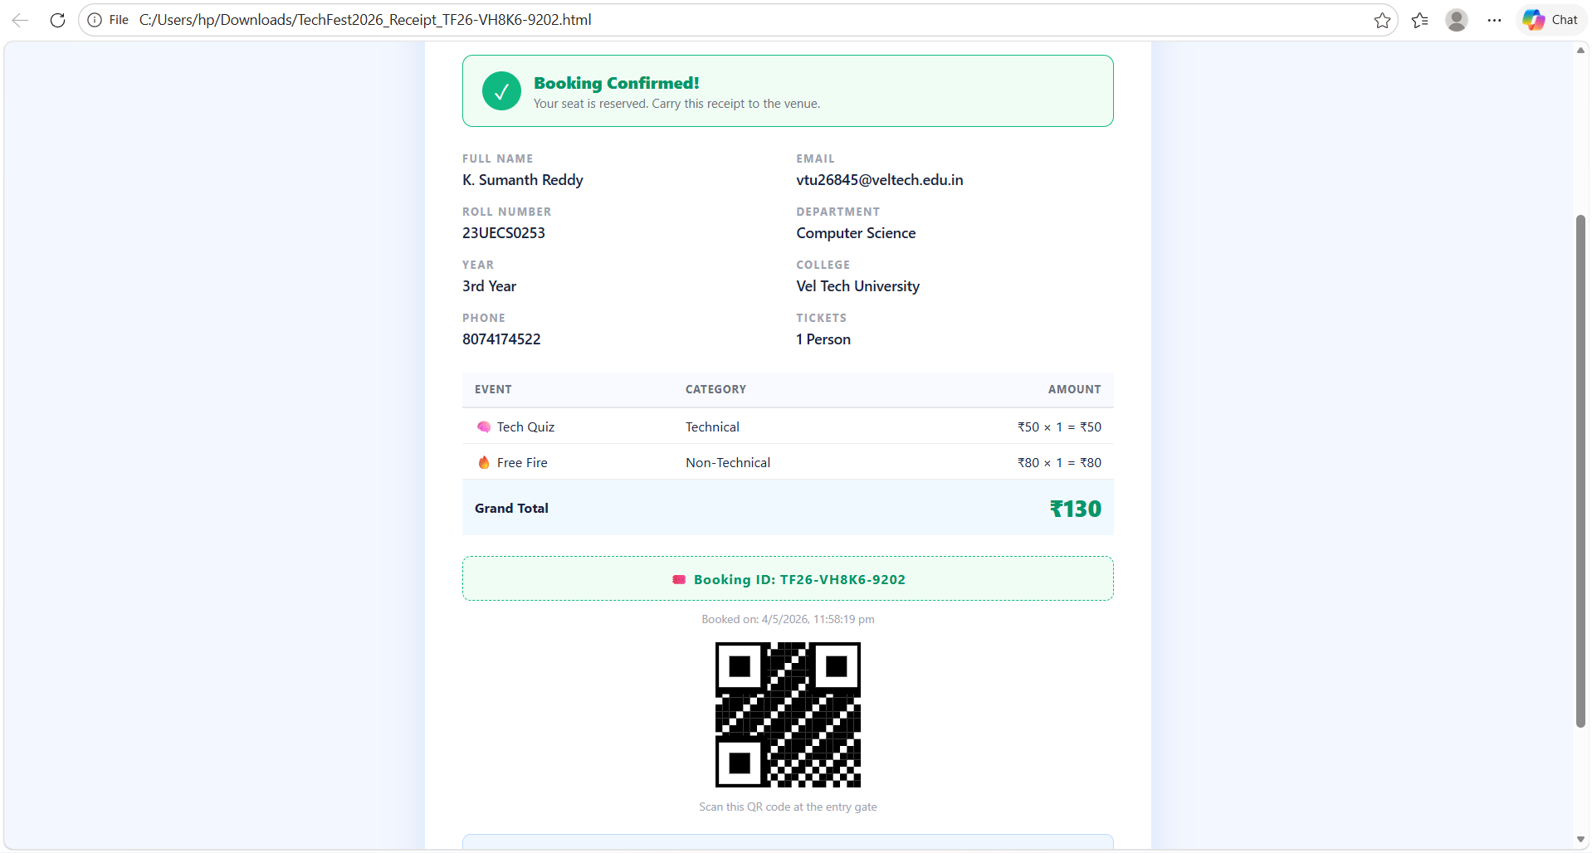
IMPLEMENTATION SCREENSHOTS
1
2
3
4
5
6
7
8(C)
9

Slide 15
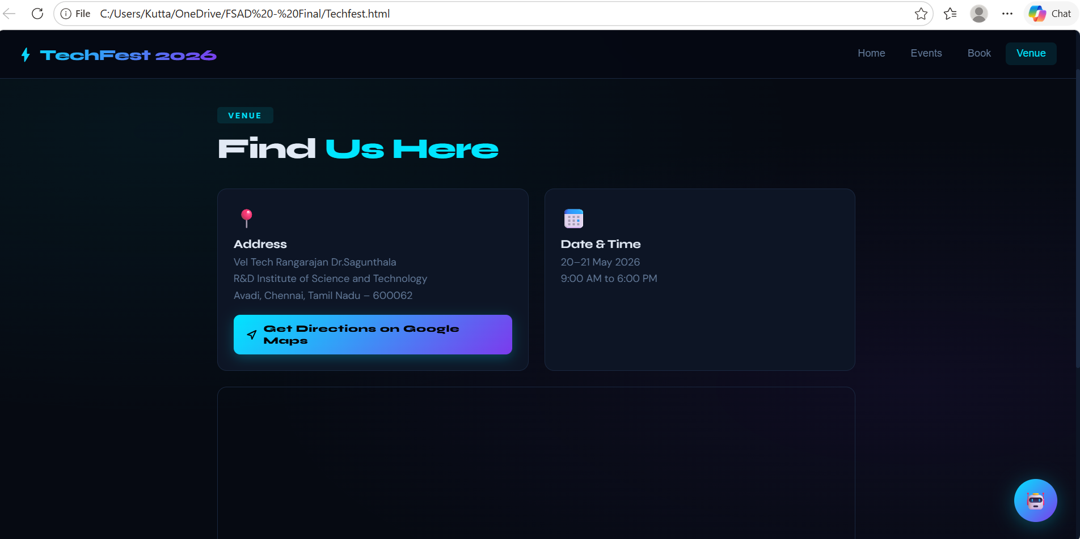
IMPLEMENTATION SCREENSHOTS
1
2
3
4
5
6
7
8(C)
9

Slide 16
ADVANTAGES & LIMITATIONS
Advantages :
Easy Booking Process: Simple interface for quick ticket booking
Real-Time Availability: Instantly updates available ticket count
QR Code Tickets: Secure and easy verification
Lightweight System: Runs directly in browser (no installation)
Instant Feedback: Shows confirmation and booking history immediately
Low Setup Cost: No server/database required (uses localStorage)
2. Limitations :
No Backend Integration: Data stored only in browser (not shared across devices)
Limited Scalability: Not suitable for large-scale or multi-user systems
Basic Security: No authentication or advanced protection
No Real-Time Sync: Multiple users cannot book simultaneously
Data Loss Risk: Clearing browser storage removes all bookings
UI Enhancements Needed: Can be improved for better design and responsiveness
1
2
3
4
5
6
7
8
9

Slide 17
Thank you

